Slide 1
Lecture 19 & Aruirregabiria and Mira(2007)
Model Description( case 3)
Estimator
MLE (maximum-likelihood estimator)
2S (two-step estimator)
NPL (nested pseudo likelihood estimator)
NPL-λ(2012)
Results

Slide 2
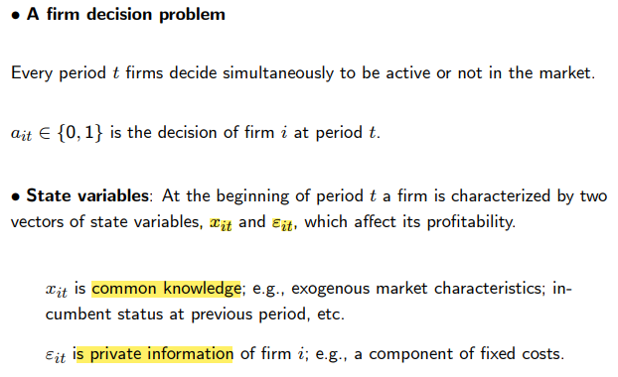
Model Description

Slide 3
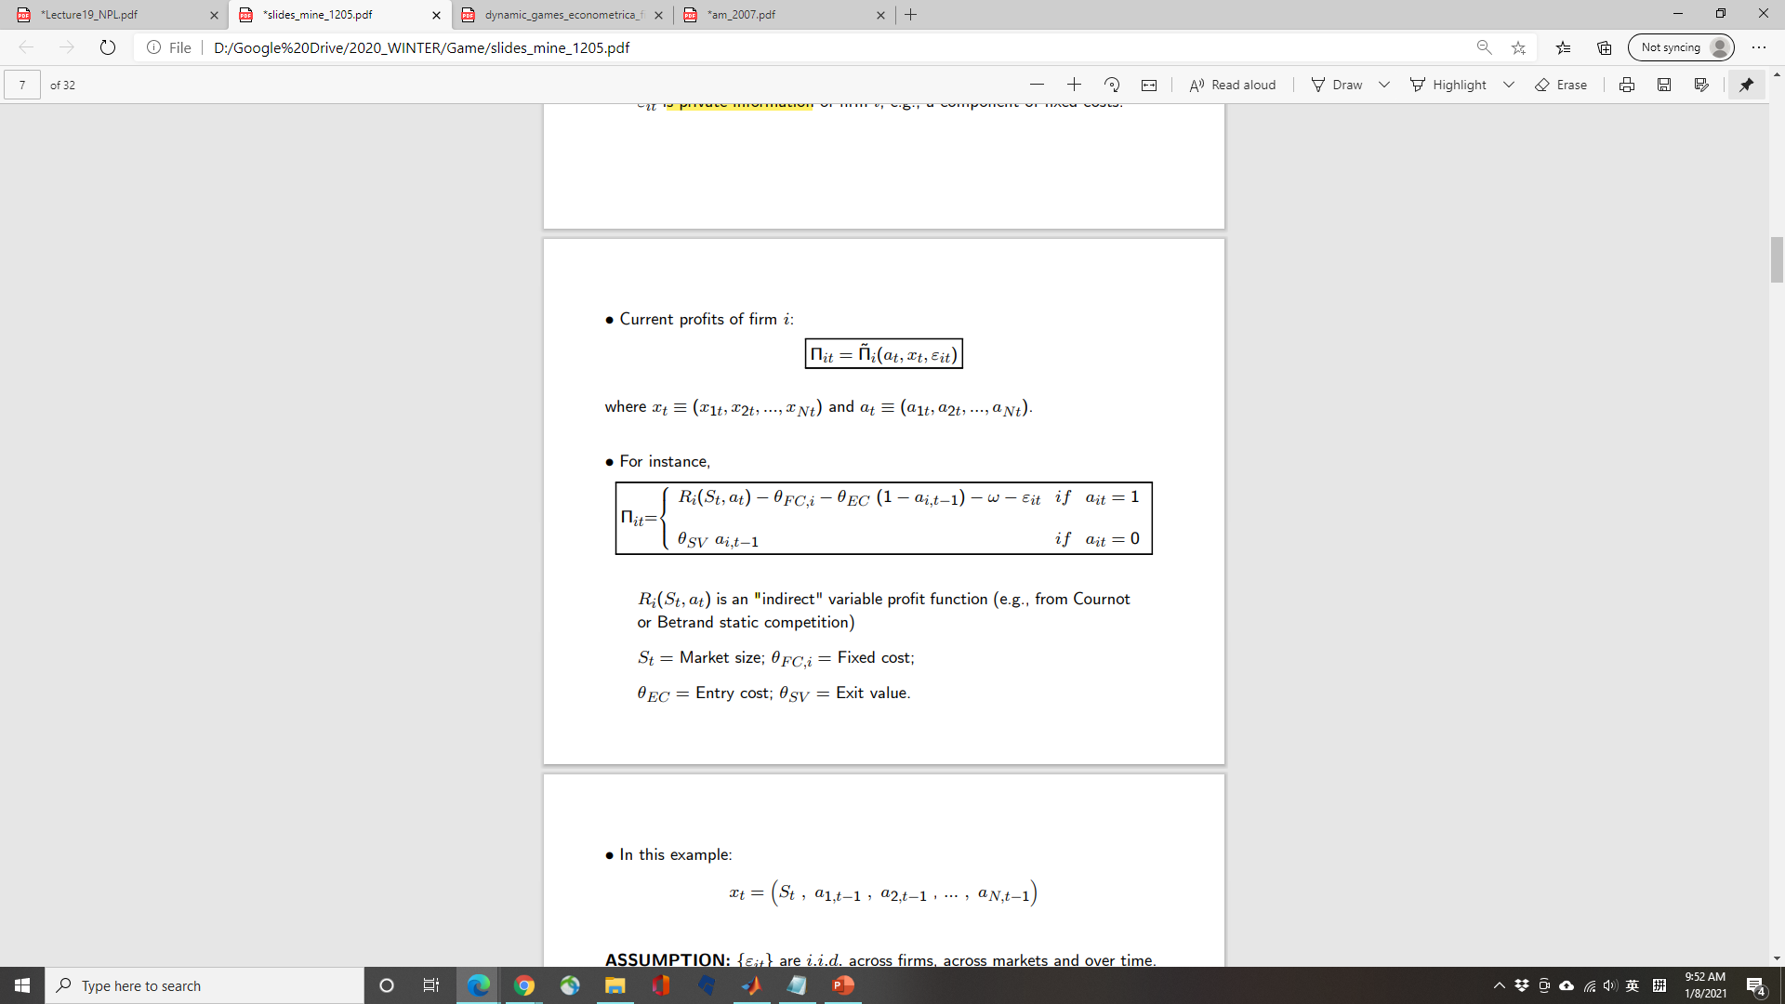
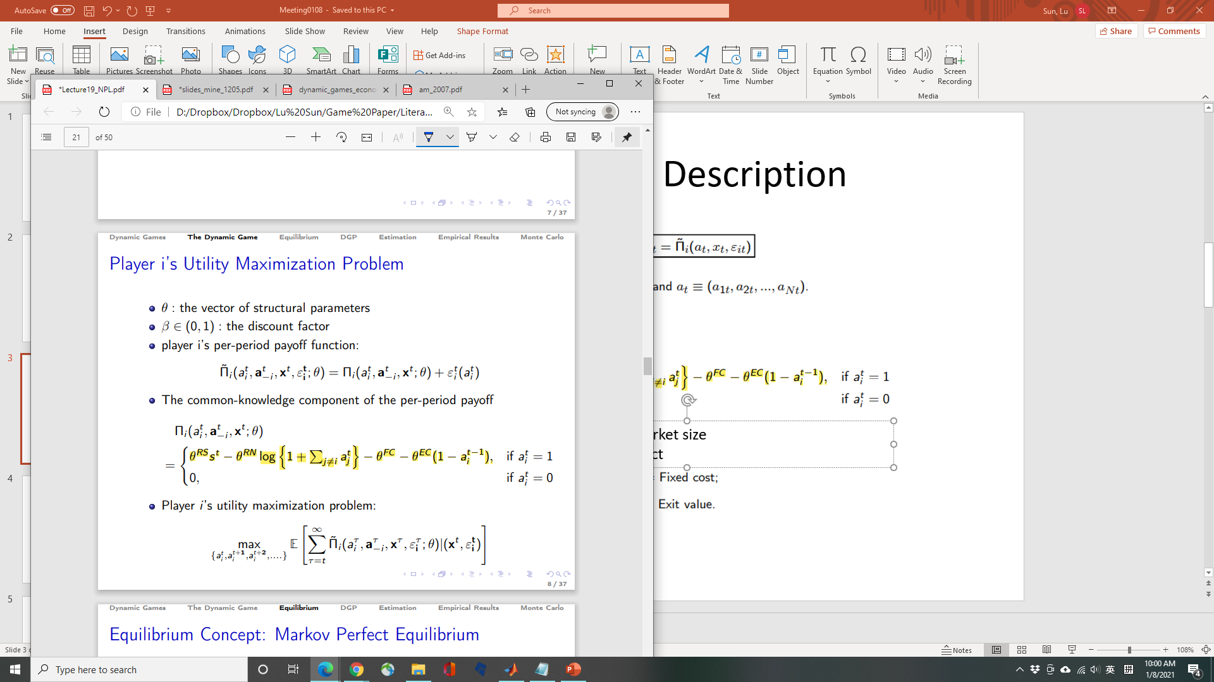
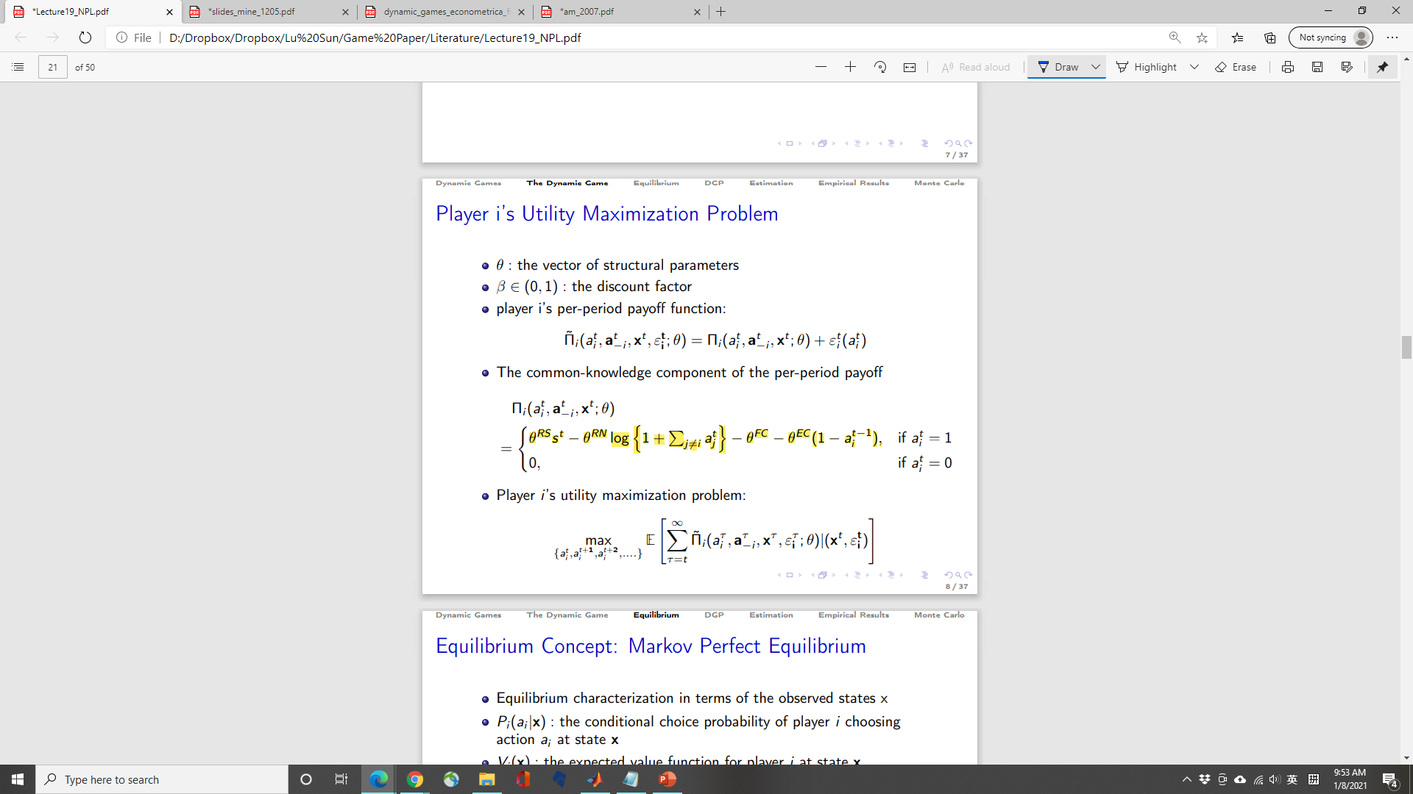
Model Description
θRS =Coefficient on market size; θRN = Competitive effect;
~ Standard Gumbel distribution

Slide 4
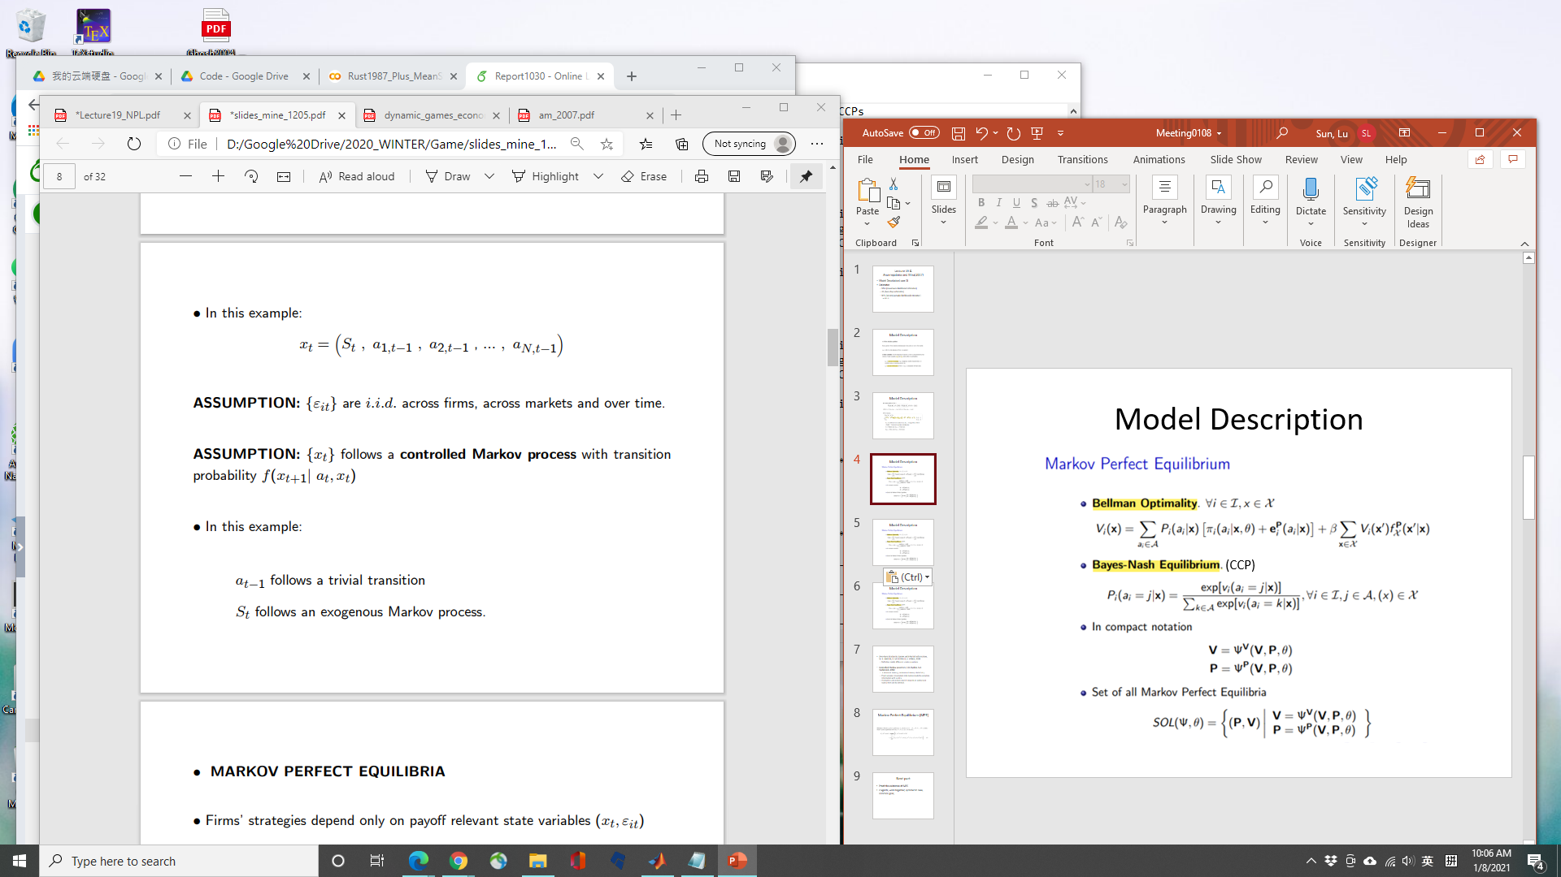
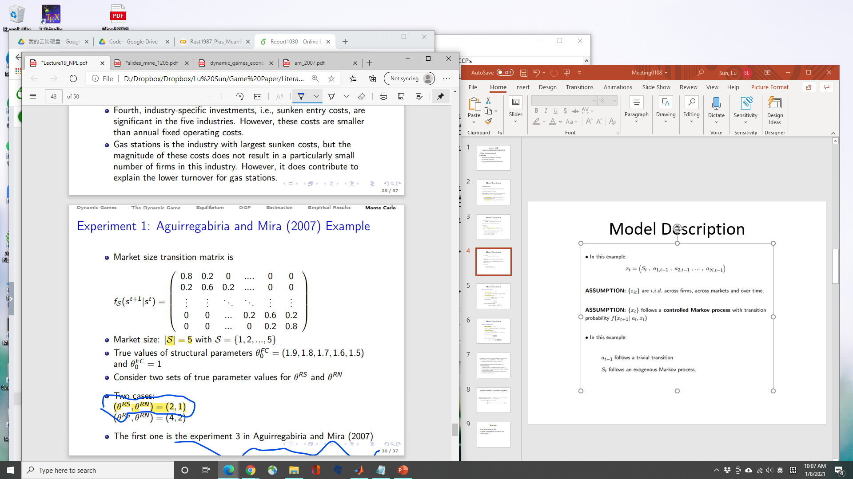
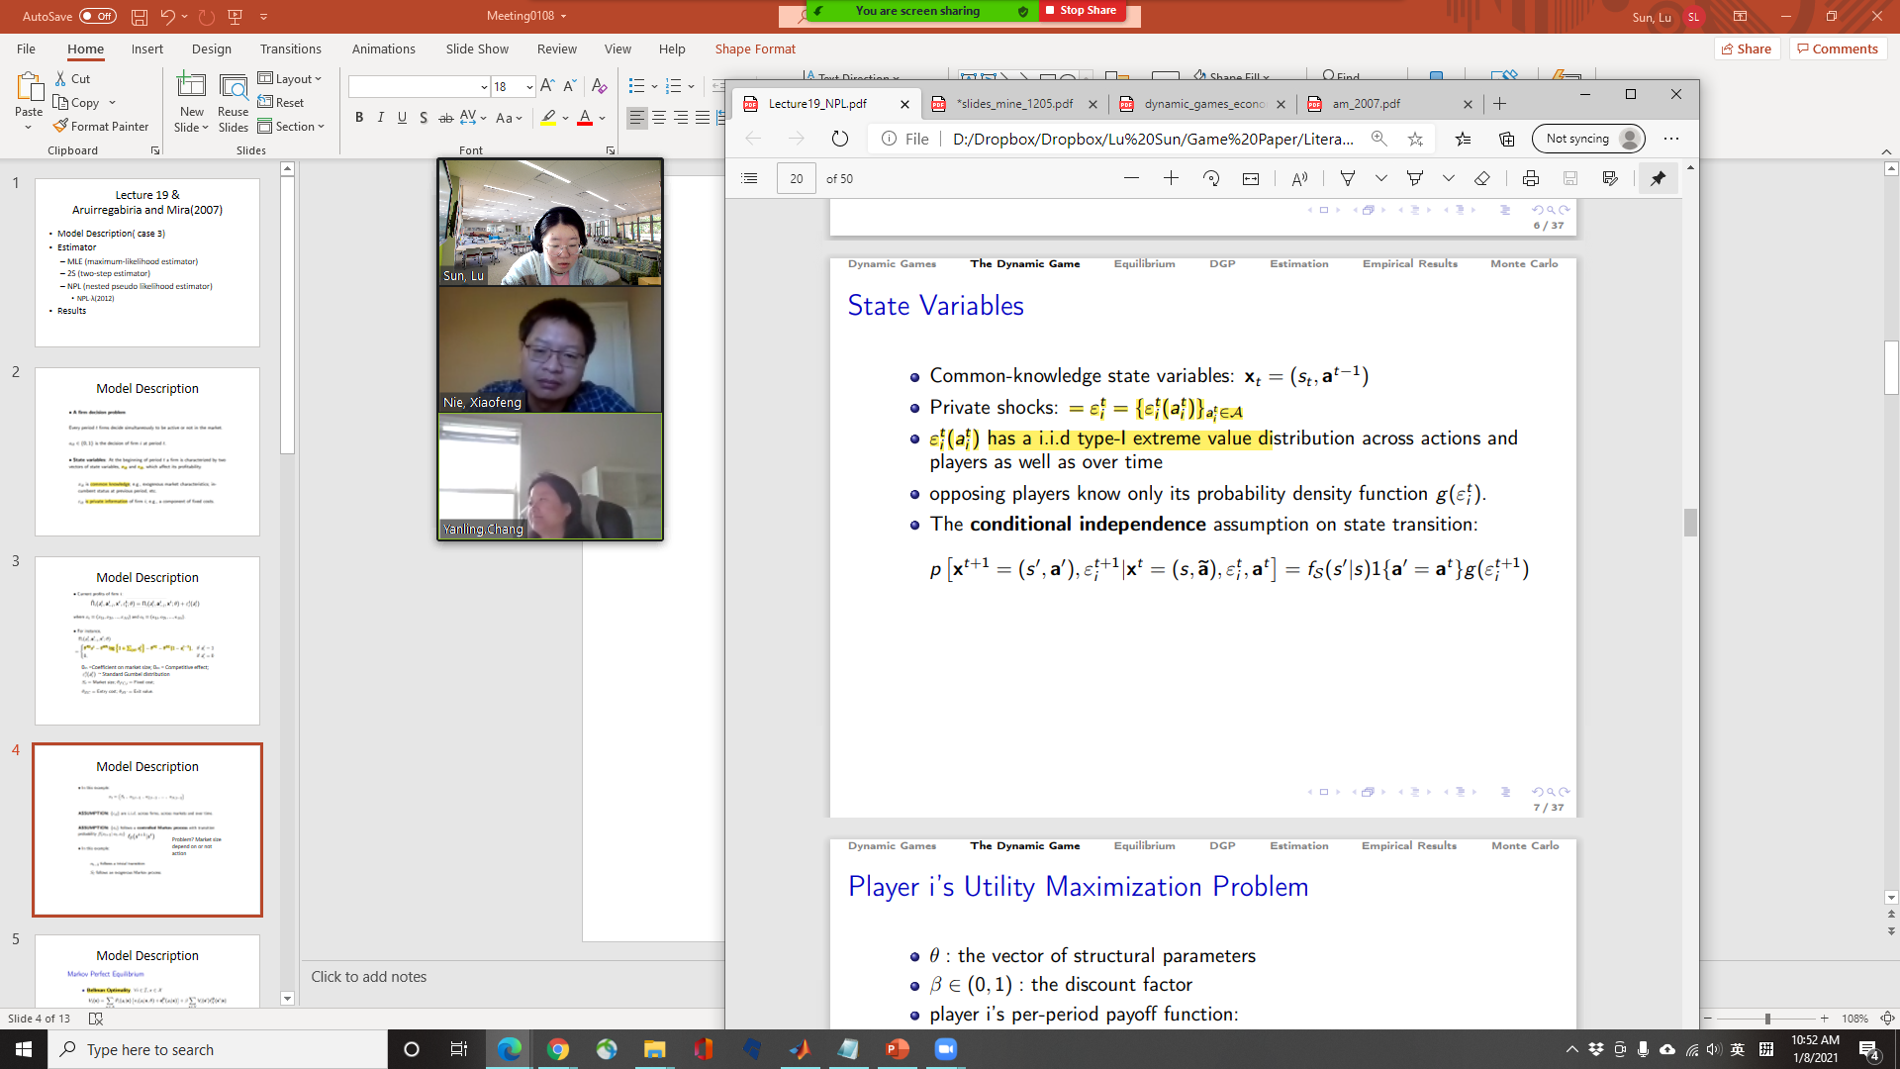
Model Description
Problem? Market size depend on or not action

Slide 5
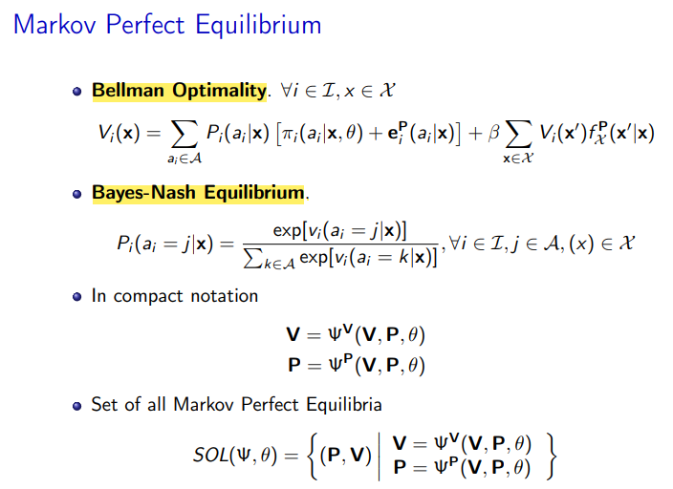
Model Description
(CCP)

Slide 6
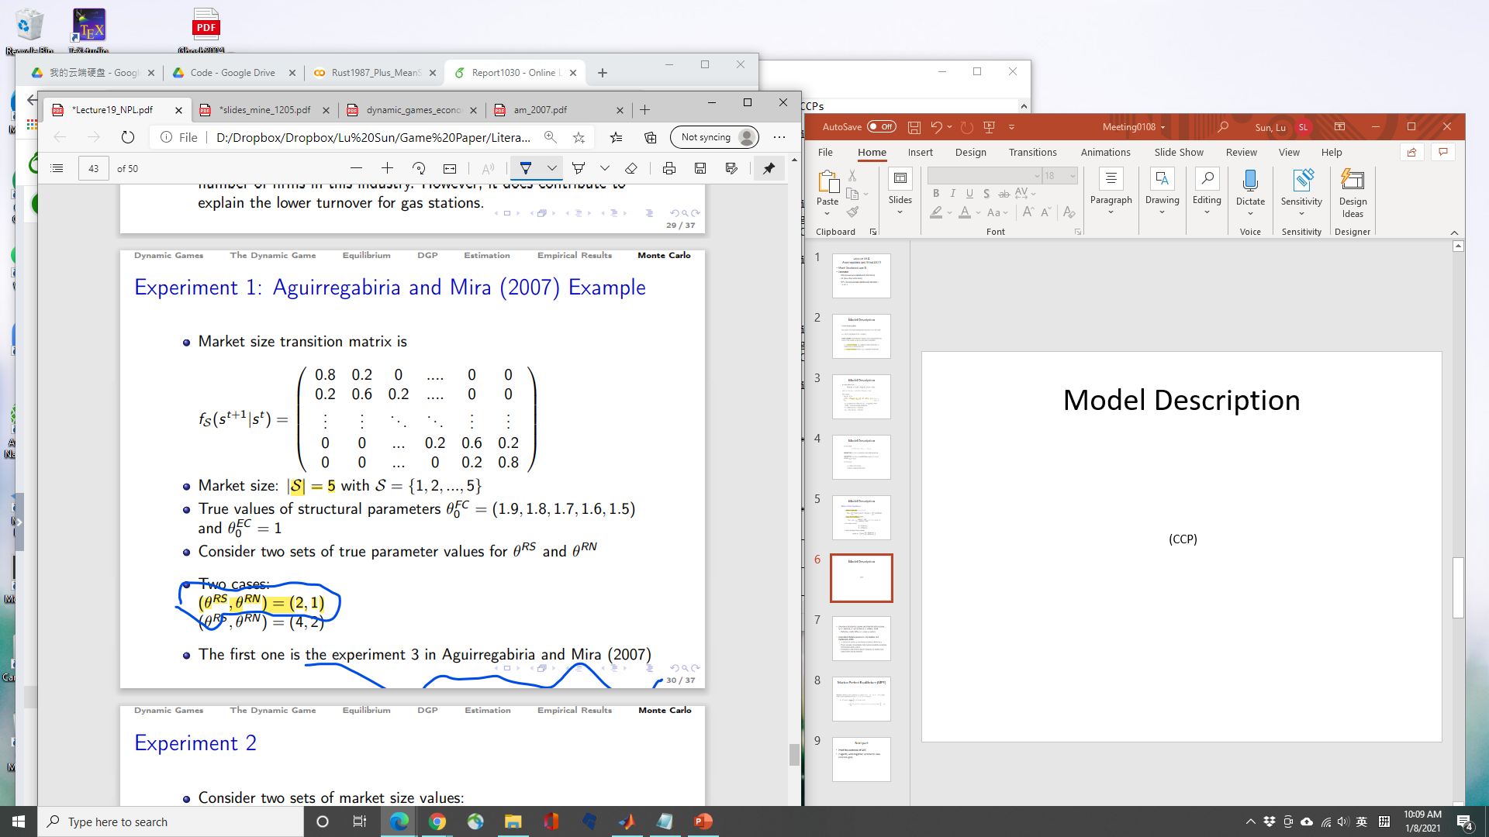
Model Description
400 observation, 1000 times simulation

Slide 7
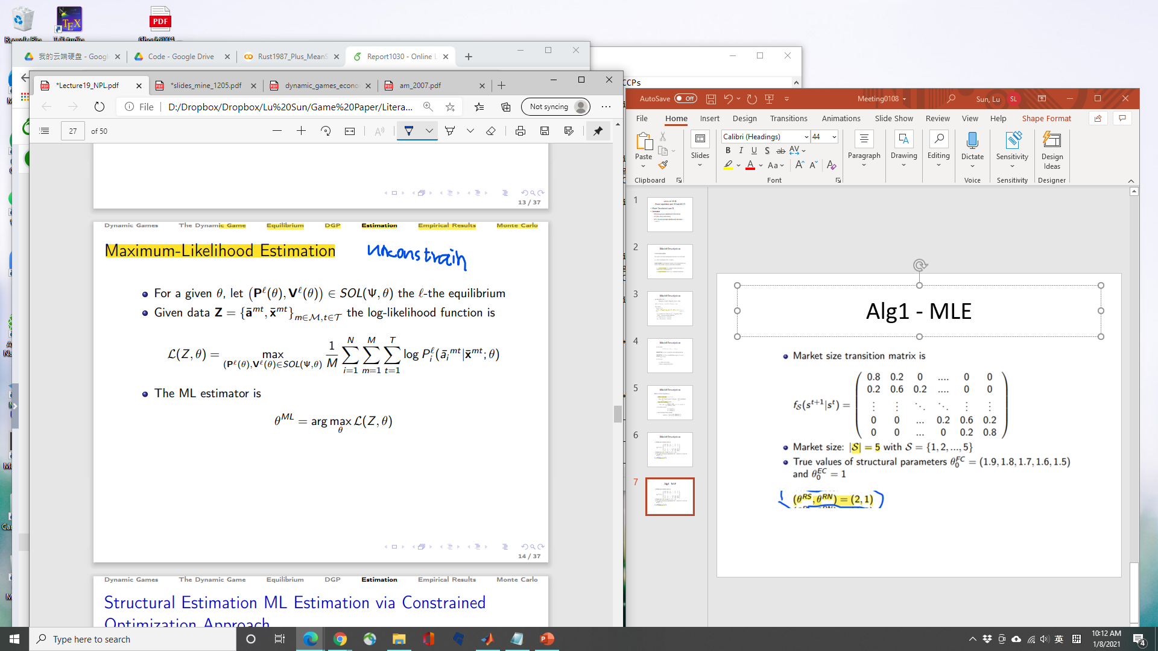
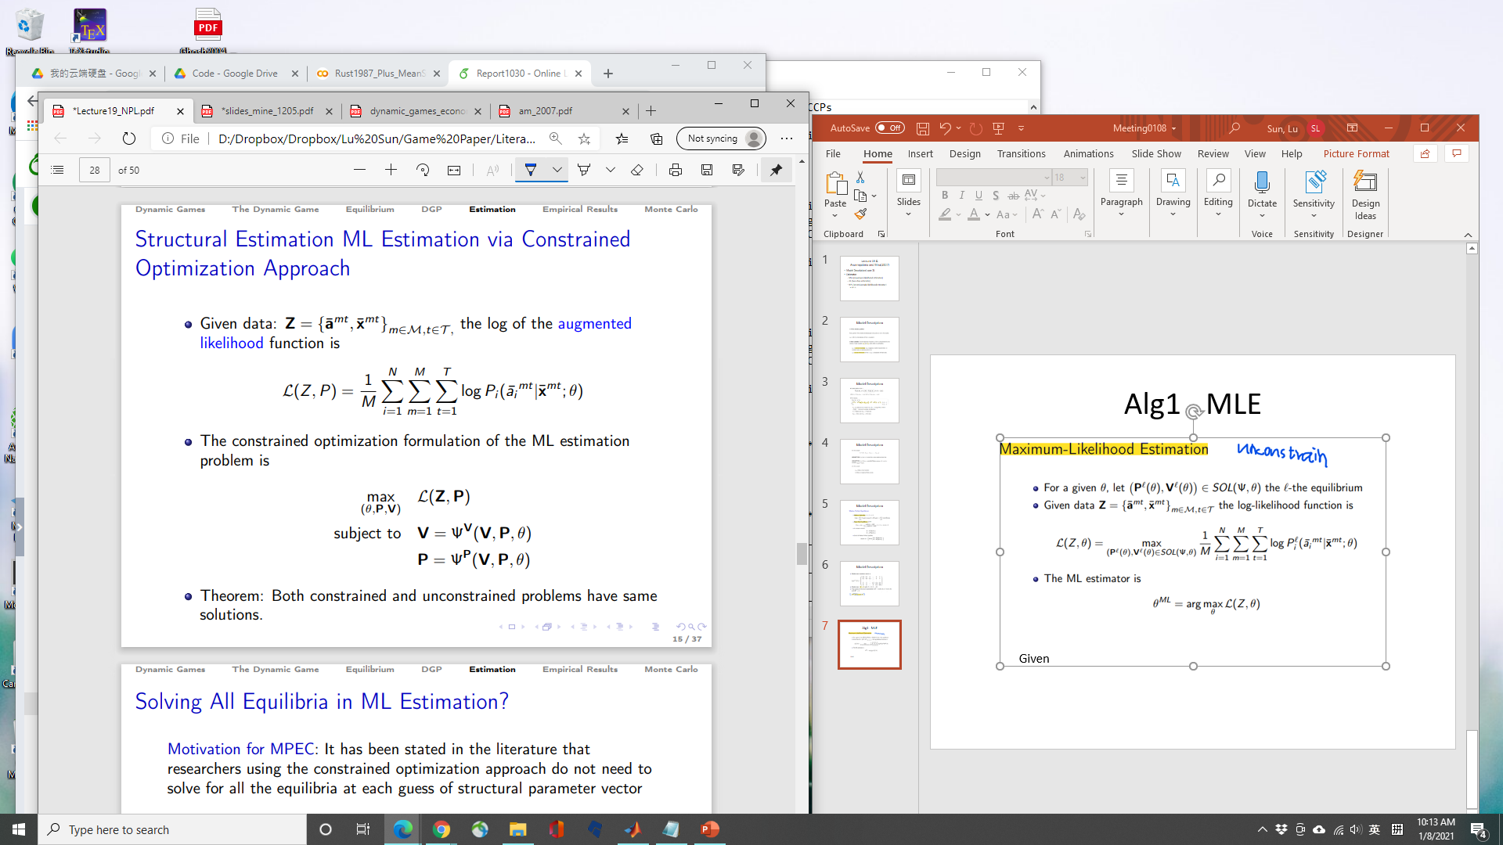
Alg1 - MLE
Or
Disadvantage: Needs a lot computation

Slide 8
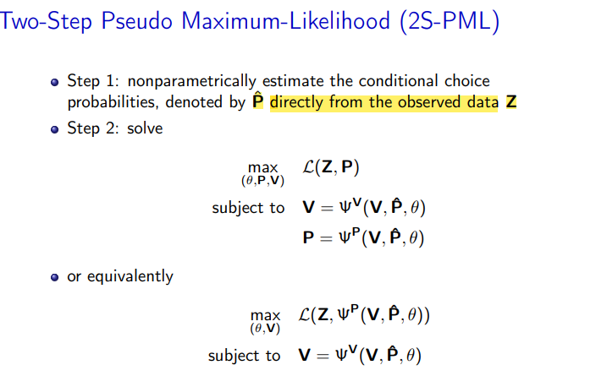
Alg2 – 2S
ents
P: 3 method (frequency, logit, random U(0,1))
Disadvantage: have large biases in finite samples

Slide 9
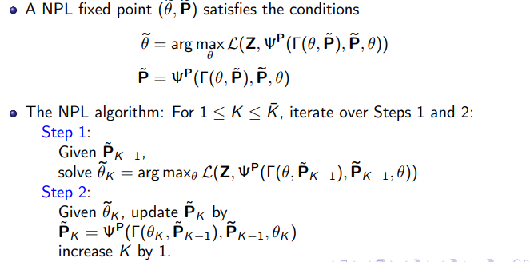
Alg3 – NPL
Disadvantage: NPL algorithm may not converge or even if it converges, it may fail to provide consistent estimates

Slide 10
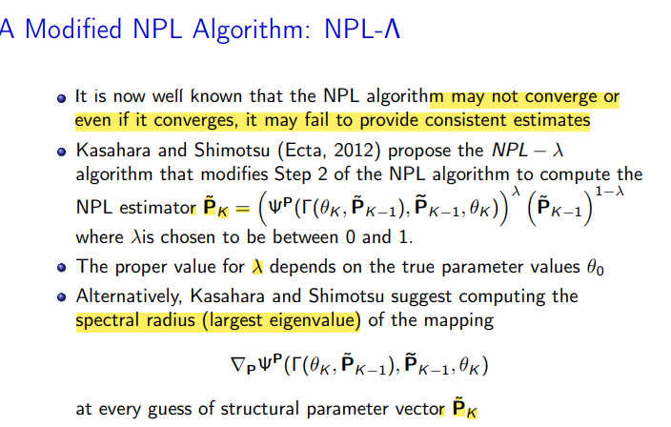
Alg4 – NPL- λ
Disadvantage: May not converge or even if it converges, it may fail to provide consistent estimates; Depends too much on λ

Slide 11
Results
Code: Guass(2007)
Code: Matlab(2019)

Slide 12
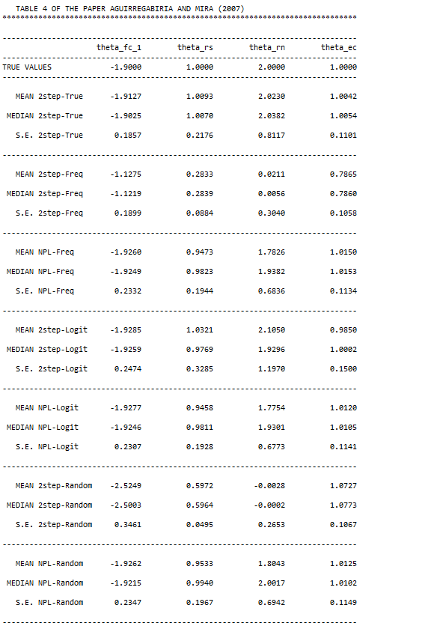
Results

